Slide 1
FOOD RECIEPE BLOG APPLICATION
Presented By: Spurthi Shetty, Pooja Pingle, Yash Khopkar, Ruta Lad, Rajashree Naik

Slide 2
EXISTING SYSTEM
Only the bloggers will be able to sign-up and login and will be able to change and delete recipes from their wall
The website includes different categories of Recipes which are displayed accordingly
There was no social media link for the recipes
There is no chat box present in the existing system.
User cannot share any blog on social media or any other platform.

Slide 3
FLAWS
The recipe should be written like a professional to attract the users. It should have two main parts – ‘The Ingredient List’ and ‘The Preparation Method’.
List all ingredients in order of use, as described in step-by-step instructions. List the most important ingredients first, if it can be consistent with order of use. The Preparation Method do not have to write complete sentences. Be as short and concise as possible. State exact or approximate cooking times, with descriptive hints for doneness

Slide 4
The site has no sections of featured, popular and latest food blogs.
The site has no filter options for the users to search for particular kind of recipes.(Eg. Indian, American recipes)
Every recipe has no comment section as well.
The blogger has no about me section on the site for the users to know about the blogger more.
No Delete feature for the users to remove the particular item from their most recently viewed list.

Slide 5
IMPROVEMENTS
Chat box.
Video tutorial for the users.
Allowing users to bookmark, add particular recipe into their wish list.
Equipment used for cooking review section.
Email Notification about new recipes.
Comments and remarks.
Sharing options on social media.

Slide 6
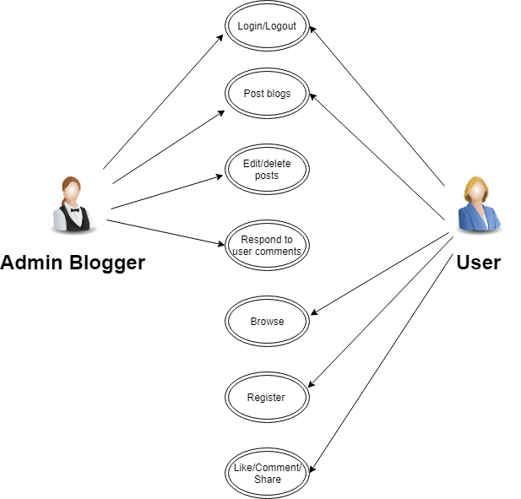
USE CASES

Slide 7
MOONSHOTS
Calorie Count and Benefits
Chat box
Live video streaming with the food blogger

Slide 8
STRATEGY PLANE(User Needs)
As a User following things will be expected:
If user is getting all the recipes of all categories from the sites
Save time and energy by creating content that specifically meets users needs.
Education - Take the education component to a new level and into a blog post.
This can be an excellent way to provide education that may otherwise be lost when
weight loss and diet take precedence.
Recipe Roundups - Providing multiple recipes on specific types of food can help your
user and other readers who wish for the same types of recipes
Recipe Development - If a dietitian maintains a food blog, finding the time to perfect recipe development skills is essential
Fitness - blog that provides educational content and recipes often based on current events and food trends.

Slide 9
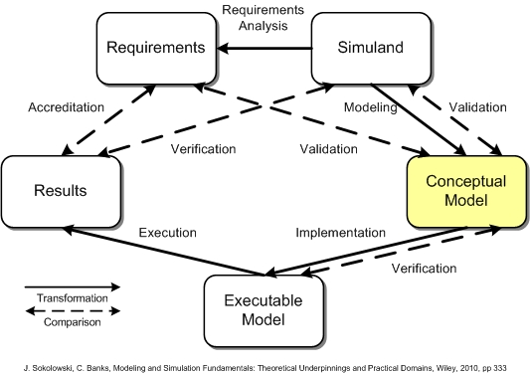
STRUCTURAL PLANE(Conceptual Model)

Slide 10
STRUCTURAL PLANE(ERROR HANDLING)
Error handling refers to the anticipation, detection, and resolution of programming, application, and communications errors.
We have implemented:
Password and email validation to ensure only valid users are allowed to access the blog.
Password verification, such as asking user to rewrite the password again and checking if both passwords are matching with each other.
These are error messages that adapt based on what invoked the validation error and use this to provide the user with helpful instructions on how they can correct their input.

Slide 11
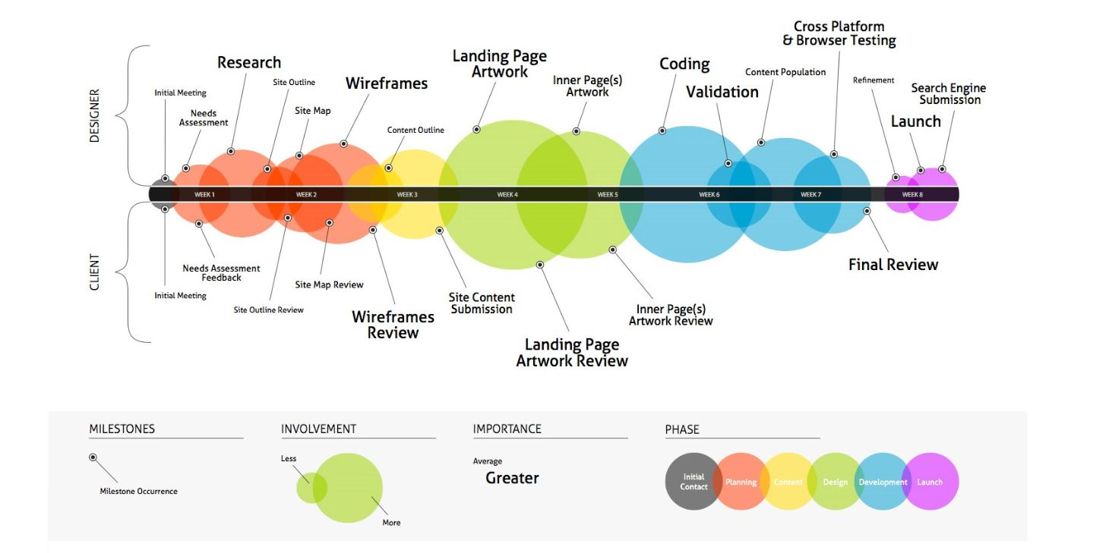
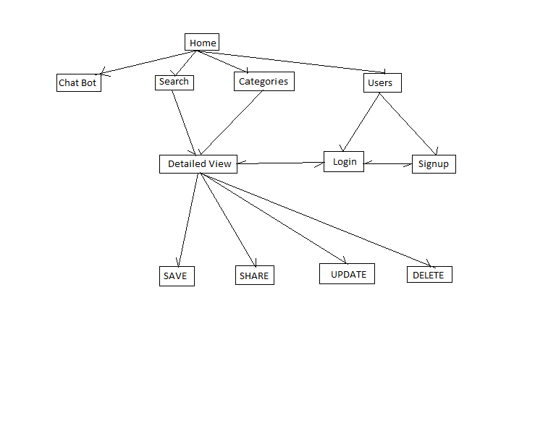
INFORMATION ARCHITECTURE

Slide 12
INFORMATION ARCHITECTURE
Week1
Initial meeting for the project
Researching on the topic.
Going through existing UI and pointing the flaws
Designing the outline of the UI
Week 2 & 3
Deciding the flow of UI
Initializing the designing of wireframes.
Week 4 & 5
Coding and validation required for the wireframes
Cross platform and Browser Testing
Delivery of final outcome.

Slide 13
Information Architecture
Designer’s Role:
Research well on the topic to be designed. Follow the feedback given by the client. Build wireframes, validate , test and deliver the outcome.
Client’s Role :
Review every stage of the project right from initial site assessment, site map and final outcome.

Slide 14
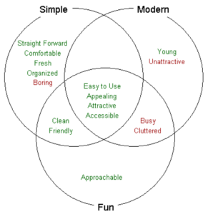
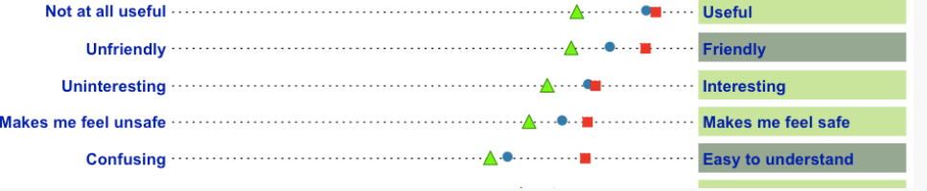
UX RESEARCH METHODS
Desirability Studies
Will Focus on Attitudinal study than the Behavioral study.
Conducting Lab study, participants will brought into a lab or conference room individually and shown different visual design directions (e.g., mood boards or high-level designs) or visually designed interfaces (e.g., high-fidelity mockups of home pages)
Participants will then given a set of index cards that have a description written on each card (usually adjectives), and participants are then asked to indicate which card goes best with each design direction.
As the study wont be enough, One simple way would be to show the results
is with a Venn diagram. For example we have three design directions
called “Simple,” “Modern,” and “Fun.” and according to that, the summary will of the
results will be divided.
Other methodology which can be used is , pairing opposites in the survey.

Slide 15
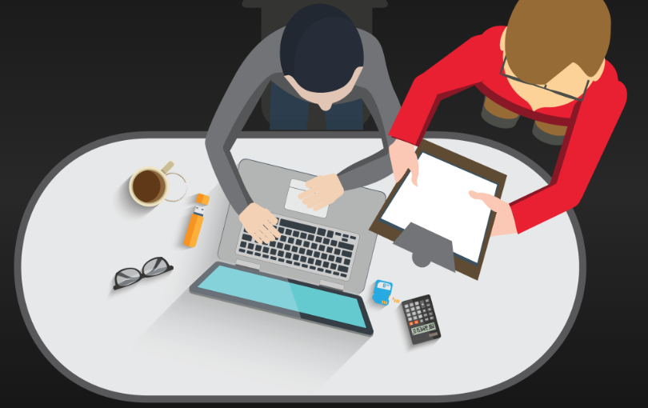
UX RESEARCH METHODS
2. Usability Lab Studies
Participants are brought into a lab, one-on-one with a researcher, and given a set of scenarios that lead to tasks and usage of specific interest within a product or service.
Considering the following measures while conducting the lab study:
Task success
Taking notes and record comments and observations at each step of the task.
Time to complete the task
Errors and hints given during the study.
Rating scales to measure users perceptions of the application.
Consider videotaping the sessions, which might be helpful for later analysis.
After the entire lab study is complete, disseminating the information to the development team.
If the budget and time allows, repeating the study to verify fixes and discover any new usability issues.

Slide 16
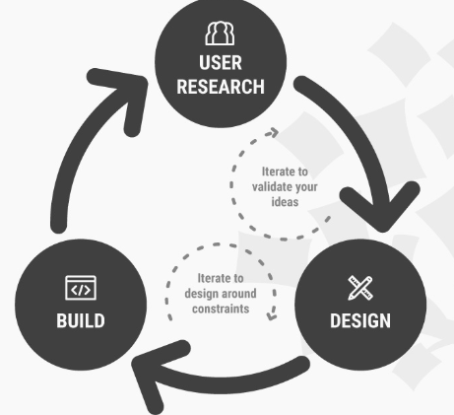
UX RESEARCH METHODS
3. Email Surveys
A survey is a set of questions used to collect topic-specific information from a representative sample of your target audience.
Keeping the survey short, focusing on one topic, and contain a mix of closed- and open-ended questions.
Short survey that might have questions such as:
Number Scale Question (quantitative) On a scale of 0 (awful) to 10 (awesome), rate your experience using
[new feature name].
2. Open-End Question (qualitative) You rated this feature a [answer from previous question] because _____:
3. Open-End Question (qualitative) If you could make one change to this product, what would that change be?
At the end consider pairing it with another research method to expound on the data.

Slide 17
UX RESEARCH METHODS
4. Customer Feedback
It provides you with the opportunity to see the customer’s perspective.You might be good at concept(idea),design and content but the implementation you need to refine continuously based on the customer needs and problems.
How to get customer feedback?
By listening and monitoring Social media channels
Face to face customer meetings
Direct emails
Feedback surveys which include visual feedback/review tools, customer interviews, in App chat box, website feedback form.

Slide 18
UX RESEARCH METHODS
5. Clickstream Analysis
It operates at the server level and tracks how many pages are served to the user, how long it takes each page to load, how often the user hits the browser's back or stop button and how much data is transmitted before the user moves on and uses clickstream data to determine the effectiveness of the site as a channel-to-market.
It is possible to track whether a visitor to a site interacts with different kinds of content. Some examples include the following:
Buttons, tabs, scroll bars and pull-down menus are pressed.
External links are copied, hovered over or opened.
When online forms are started, abandoned, completed or submitted.
A video is started, stopped, replayed or paused.
A visitor begins a podcast and how far into the episode they listen.
Gadgets and widgets are hovered over or interacted with.
An image is clicked on, opened or saved.
The movement of the mouse is recorded over the period of time the visitor is on the webpage.

Slide 19
PERSONAS
Chef: Chefs will be able to see various recipes and add their own discovered recipes, link those recipes with a live streaming video.
Dietician: With a high demand for food and nutrition blogs, it’s worthwhile for nutrition professionals to learn more about them and maybe even create their own. Dietician could effectively view recipes calorie counts and accordingly suggest recipes to their patients and clients.

Slide 20
PERSONAS
Blogger: Bloggers can view various recipes and look at the ingredients, methods to cook. They can even provide feedback/ improvements which they feel can make the recipes better or ask questions .
Normal user: Users can view various recipes and look at the ingredients, methods to cook, interact with other users and view preparation videos. Can add their own creation too.

Slide 21
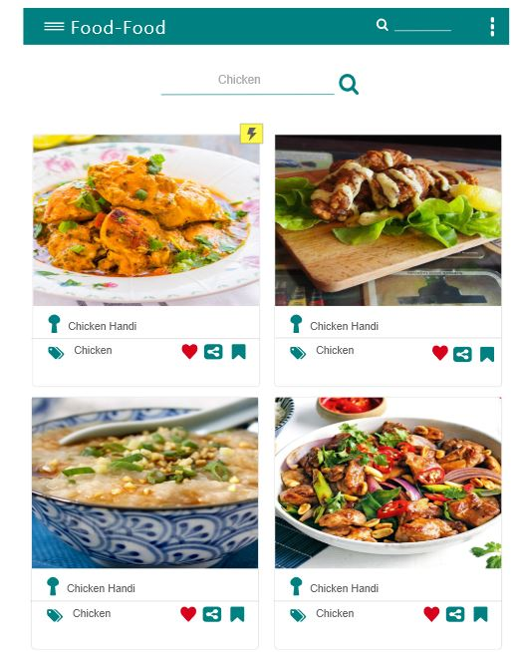
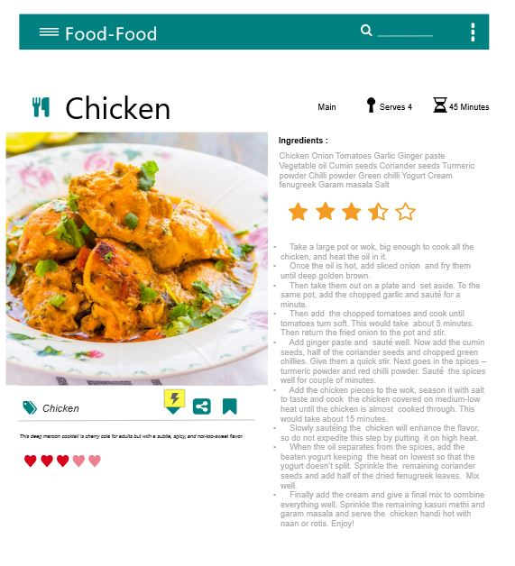
WIREFRAME MODEL

Slide 22
THANK YOU!

